Slide 1







GCPH Contact Information
PRESENTERS:
Kelly Ray, REHS
Public Health Sanitarian
(937) 374-5610; kray@gcph.info
Melanie Straight, EHSIT Public Health Sanitarian
(937) 374-5618; mstraight@gcph.info

Slide 2


Introduction to Pools and Spas
Presented by:

Slide 3
Purpose of Pool & Spa Safety
Protect the public from possible safety and health hazards
Provide a basic knowledge of regulations from the health code
Build a good relationship between pool operators and the health department

Slide 4
Rules and Regulations
Pool operators must be aware of many requirements to safely operate their pools. These requirements are important to the health and safety of the patrons, and all people who are in charge at the pool should be aware of the regulations.
  Greene County Public Health (GCPH) – a local public health agency that regulates pools/spas
  Ohio Department of Health (ODH) – a state public health agency that creates regulations
and sets minimum standards within the state of Ohio.
  The Occupational Safety and Health Administration (OSHA) – Protects the safety of workers
  The Center for Disease Control and Prevention (CDC) – Does not regulate, but advises and investigates outbreaks of communicable disease
  Consumer Product Safety Commission (CPSC) – protects the public from
unsafe products. Example: VGB.

Slide 5
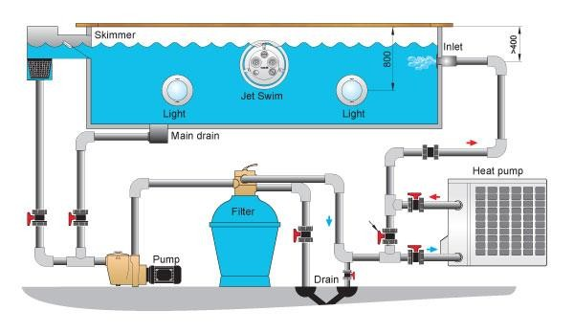
Overview Anatomy of a Pool/Spa

Slide 6





Health Concerns
Germ | E. Coli 0157:H7 | Hepatitis A | Giardia | Cryptosporidium
Time | Less than 1 minute | About 16 minutes | About 45 minutes | About 15,300 minutes or 10.6 days
◆ It is possible to spread illness from person to person via pool or spa water
◆ Common forms of these illnesses include: E. coli 0157:H7, Hepatitis A, Giardia, and Cryptosporidium (Crypto)
◆ Disinfecting and keeping proper water chemistry in the pool/spa will reduce the risk of these pathogens

Slide 7
How Are Illnesses Spread at Aquatic Facilities?
◆ These illnesses are not only spread by blood - most can be spread:
◆ By swallowing contaminated water
◆ By accidentally swallowing something that has come in contact with the stool
of a person or animal infected with the germ
◆ By swallowing the germ picked up from surfaces (such as lounge chairs, picnic tables, bathroom fixtures, changing tables) contaminated with the stool from an infected person

Slide 8
How do I promote healthy swimming?
◆ Encourage swimmers TO:
◆ Practice good hygiene such as:
◆ taking a shower before swimming
◆ washing their hands after using the toilet
◆ changing diapers
◆ Take children to the bathroom on breaks and change swim diapers often
◆ Only change diapers in the bathroom
◆ Wash children thoroughly (especially the rear end) with soap and water before swimming

Slide 9
How do I promote health swimming?
◆ Encourage swimmers NOT TO:
◆ Swim when they have diarrhea
◆ Swallow the pool water
◆ Change diapers poolside

Slide 10
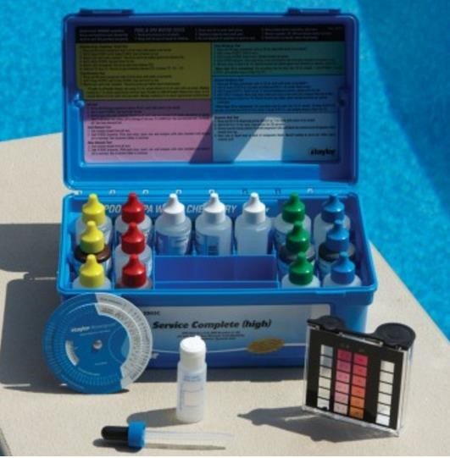
Testing the Water
◆ It is required that each licensed pool or spa have a diethyl-p-phenylediamine (DPD) test kit
◆ Read directions
◆ Store in a cool, dark place
◆ Keep equipment clean
◆ Do not mix test kits
◆ Replace reagents yearly

Slide 11
Testing the Water
◆ Remember these tips:
◆ Test pools at opening and at least once every 4 hours unless using an automatic chemical controller, in which case these must be manually tested every 12 hours
◆ Obtain sample away from inlets and outlets
◆ Ensure that the comparator tube is placed at least 18 inches below the surface (elbow deep) to ensure accuracy
◆ Test logs must be kept on file for at least 2 years
◆ Calibrate your thermometer regularly
◆ Ensure that all chemical treatments have completely dissolved and mixed prior to re-testing or allowing entry into the pool

Slide 12

Water Chemistry
Required Levels
 | Required Levels
Free Chlorine | Pools: At least 1 ppm Spas: At least 2 ppm
Combined Chlorine | Less than 1 ppm
Bromine | Pools: At least 2 ppm Spas: At least 4 ppm
pH Values | 7.2-7.8
Total Alkalinity | At least 60 ppm
Cyanuric Acid | Less than 70 ppm
Temperature | Pools: Not above 90°F Spas: Not above 104°F

Slide 13
Water Quality & Disinfectant Types
Salt
The salt solution passes through an electrolytic cell which produces chlorine from the chloride ion in salt
Appropriate levels to maintain a proper chlorine level is about 2,500 to 4,000 ppm.
This amount of salt is undetectable to bathers
The cells also need to be routinely cleaned to ensure they are working properly
Other types of Disinfectant
Sodium Hypochlorite (Liquid chlorine)
Bromine
TriChlor/DiChlor
Ultraviolet Light
Ozone
Ionization – Copper/Silver
Calcium Hypychlorite

Slide 14
Water Quality & Disinfectant Types
Chlorine
Free Chlorine = available disinfectant
Combined Chlorine (aka Chloramines) = result of free chlorine combining with organic compounds containing nitrogen (N) – such as urine
Total chlorine – free chlorine = combined chlorine
Free chlorine: > 1ppm for pools and > 2 ppm for spas
Combined chlorine is ideally ZERO. Too much can create the “chlorine”
smell in indoor facilities

Slide 15
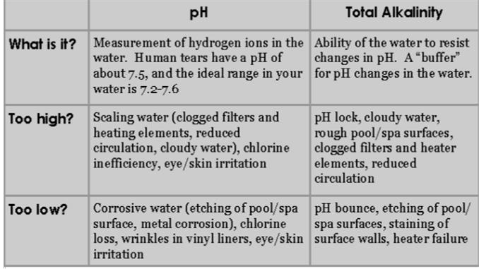
Common Water Balance Factors

Slide 16
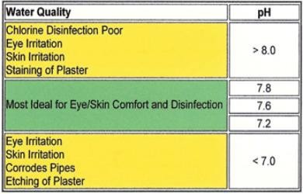
Other Water Balance Factors
pH
Temperature
◆ Temperature is a physical factor that contributes
to water quality
◆ In pools, the water temperature should not be higher than 90° F
◆ In spas, the temperature should not be above
104° F
◆ At high temperatures, the disinfectant can quickly evaporate, or in the spa,
scalding can occur

Slide 17
Operational Requirements
Draining Requirements
Spas must be completely drained at least once every 30 days
Draining is also necessary when water chemistry concentrations are off and no other chemical treatments are successful
Cyanuric acid levels can only be reduced by draining
Flow requirements
The flow rate is the rate of water flow through the circulation system
Flow rate is measured in gallons per minute (GPM)
Must have a working flow meter at all times to ensure proper circulation of disinfectants/turn-over rates
If the float is stuck, try cleaning
the flow meter
If minimum flow rate is not being achieved, clean filters
Mixing/Holding Tank
These are often found at spray grounds
They must be cleaned and drained at least once every 120 days

Slide 18
SVRS Systems
Safety Vacuum Release System (SVRS)
◆ Safety Vacuum Release Systems are required on pools or spas with one main drain on direct
suction
◆ This device senses a blockage on the drain and reduces or eliminates suction at the drain
◆ Should be mounted ahead of the hair and lint strainer in the equipment room or integrated with
the pump

Slide 19
VGB
VGB Main Drain
◆ Main drains are important to your pool’s operation
◆ Main drains must be in the deepest area of the pool or spa
◆ Drains must be covered with VGB-compliant grates that require the use of tools for removal (be certain to verify manufacturer’s expiration dates/check for recalls)
◆ Pools or spas on direct suction and no SVRS must have 2 drains a minimum of 3 feet apart unless
the drain is considered un-blockable (greater than or equal to 18 inches x 23 inches)
◆ Main drains must be visible

Slide 20
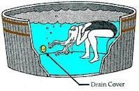
Virginia Graeme Baker Requirements
Entrapment hazards
◆ Hair
◆ Limbs
◆ Jewelry
◆ Disembowelment
/evisceration

Slide 21
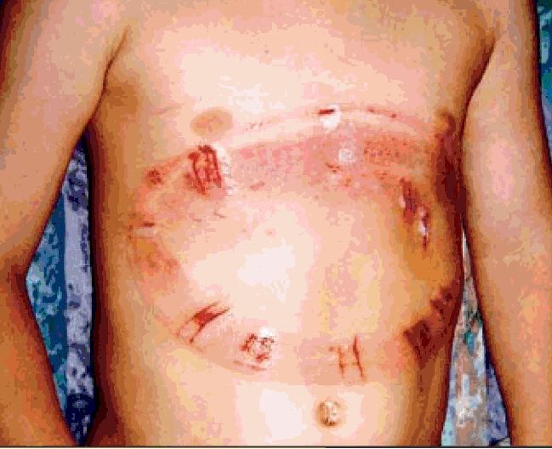
Virginia Graeme Baker Requirements
◆ Entrapment on main drain

Slide 22
Virginia Graeme Baker Requirements
◆ Unblockable drain covers
◆ Main drains
◆ :Single drain: 18”x23”
◆ :Two drains: minimum 3’ between
drains
◆ Equalizer lines
◆ Covers?
◆ Plugs?
◆ Other submerged outlets

Slide 23
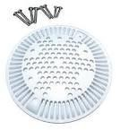
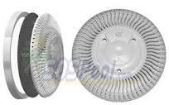
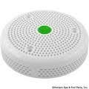
Virginia Graeme Baker Requirements
◆ VGB Compliant Outlet Covers
(Equalizer lines)
◆ Plugs in sidewalls

Slide 24
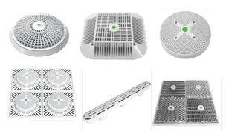
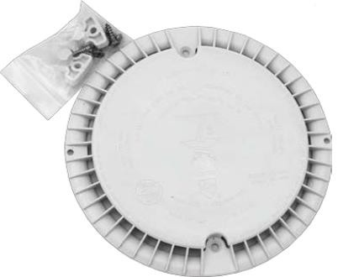
Virginia Graeme Baker Requirements
VGB Compliant Drain Covers

Slide 25

Virginia Graeme Baker Requirements
◆ Look for the ASME symbol
embossed on cover

Slide 26
Virginia Graeme Baker Requirements
Single Main Drains
◆ Single Main Drains
◆ Compliant covers :Licensee must
keep written documentation on file
◆ Secondary means of entrapment prevention: Monthly tests results taken and recorded on Weekly report forms by licensee

Slide 27
Virginia Graeme Baker Requirements
Multiple Drains
◆ Multiple Drain Covers
◆ VGB Compliant covers
◆ Minimum Distance Between Drains

Slide 28
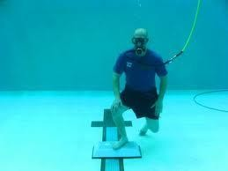
Virginia Graeme Baker Requirements
◆ And, yes, you may indeed need to verify the compliance of those drain covers!

Slide 29
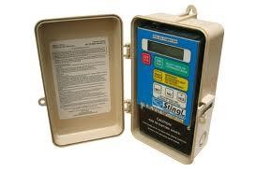
Virginia Graeme Baker Requirements
◆ Stingl (SVRS)

Slide 30
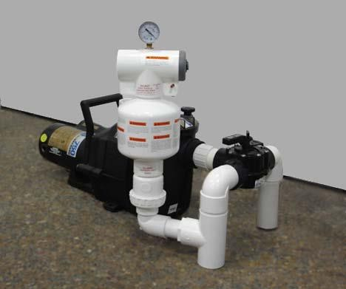
Virginia Graeme Baker Requirements
◆ Vac-Alert (SVRS)

Slide 31
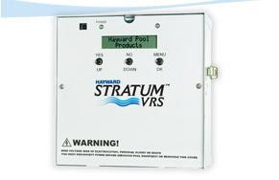
Virginia Graeme Baker Requirements
◆ Stratum (VRS)

Slide 32
Equipment Maintenance
◆ It can be easy to neglect the equipment room, because it is hidden from the view of the public.
However, it is important to ensure that this room is:
◆ Clean and well-drained
◆ Damaged walls, etc. are repaired
◆ Adequately lit and ventilated, and
◆ Not accessible to bathers and patrons
◆ Ensure that skimmers are cleaned regularly
◆ The disinfection system must be maintained
◆ The automatic chemical controller probes must be calibrated and maintained
◆ Hand dosing to continuously disinfect the pool is unacceptable!

Slide 33
Facility Safety
Mandatory Fencing Guidelines
◆ All fences must be at least 48 inches high measured from the ground (wading pools must have a
fence at least 36 inches high)
◆ All perimeter fences or barriers must not have any opening that will allow a sphere with a diameter of 4 inches to pass through
◆ All doors or gates must be self-closing, self-latching, lockable (require a key for entry) and the
latch must be at least 38 inches from the ground
◆ All barriers must be locked whenever the pool is closed

Slide 34
Facility Safety
Safety Checklist
◆ Spineboard (headgear on guarded pools)
◆ Working emergency telephone w/instructions (example: dial 9) and emergency numbers
◆ First Aid supplies (bandages, gauze, disposable gloves, etc.) – cannot be in a locked room!
◆ Self-closing gates
◆ Ring Buoy and rope, non-telescoping reach pole
◆ Shepherds crook if no lifeguard
◆ Ladders and diving boards are secure
◆ Verify that underwater lights work
◆ Starting blocks inaccessible

Slide 35
Required Signage
◆ “No Diving” for depths < 5 feet
◆ Depth Markers (at least 4 inches high)
◆ If no lifeguard:
◆ “Warning, No Lifeguard”
◆ “Swimming alone is not recommended”
◆ “Children must be supervised”
◆ Anytime the pool or spa is closed, you must post at least one sign stating
“Danger – Pool (or Spa) Closed” or “Warning – Pool (or Spa) Closed”

Slide 36
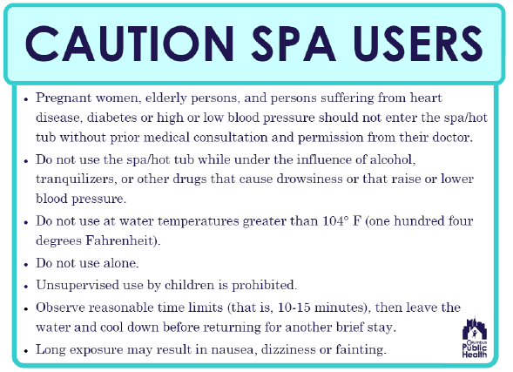
Required Spa Signage

Slide 37
Signage for Spray Grounds
◆ Using same or similar language as listed below:
◆ Do not use pool while having diarrhea
◆ Water is not to be swallowed
◆ Wash hands after using the restroom or changing diapers
◆ Take regular restroom breaks or change diapers only in a restroom
◆ Manufacturer’s safety recommendations must be posted conspicuously

Slide 38
Signage for Slides
◆ Safety recommendations must be posted conspicuously at the slide
◆ Only one user at a time, no chains
◆ Check to see that landing areas are clear before entering the slide
◆ Users must exit the landing area immediately
◆ Feet first
◆ Minimum user height must be posted
◆ Life jackets or other flotation devices are prohibited other than those
designed for the slide and used as directed by the manufacturer

Slide 39
Lifeguards
When are lifeguards required?
◆ All pools with diving boards
◆ All pools with recreational slides
◆ All pools with surface areas of 2,000 square feet or greater
◆ All pools with a surface area of less than 2,000 square feet and more than 50 people occupying the pool
◆ All pools with zero depth entry with depths more than 18 inches
◆ Public swimming pools that are 6,000 square feet or larger must have a written plan that shows adequate lifeguard coverage.

Slide 40
Lifeguards
Lifeguards must…
◆ Be capable swimmers
◆ Have a clear and unobstructed view of the pool bottom and areas under supervision
◆ Hold a current valid certification as a lifeguard
◆ Be certified in CPR and First Aid (pool operator must maintain copies of certifications)
◆ Be prepared to enter the water at any time
◆ Have a rescue tube and a CPR pocket mask on their person
◆ Be similarly attired and readily identifiable

Slide 41
Record Keeping
◆ Document the following at opening and every 4 hours:
◆ Free, total, and combined chlorine (if applicable)
◆ Bromine (if applicable)
◆ Water clarity, pH & Temperature
◆ All chemicals added
◆ Document the following on a daily basis: All injuries and fecal accidents
◆ Document the following on a weekly basis:
◆ Total alkalinity
◆ Stabilizer (CYA) if used
◆ For a pool/spa using an automatic chemical control system, disinfectant and pH data must be manually tested and recorded every 12 hours.

Slide 42
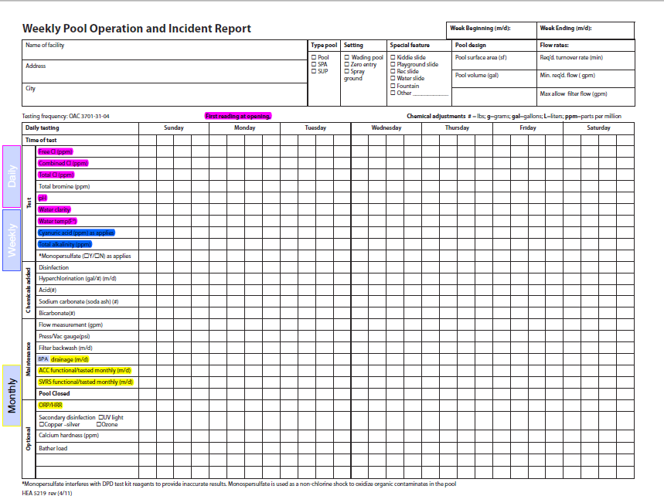

Slide 43
Chemical Storage
◆ Follow product label directions for chemical storage:
◆ Dress for safety by wearing appropriate safety equipment (for example, safety goggles, gloves, and mask)
◆ Separate incompatible chemicals (for example, acid and chlorine)
◆ Lock chemicals up to protect people and animals
◆ Keep chemicals dry and do not mix different chemicals
◆ Keep chemicals cool in a well-ventilated area away from direct sunlight
◆ Keep chemicals closed in original, labeled container
◆ Store liquid chemicals low to prevent accidental contact with chemicals stored below them

Slide 44
Chemical Safety
◆ Dress for safety by wearing appropriate safety equipment
◆ Never mix
◆ Chlorine products with acid, which could create toxic gases
◆ Different pool chemicals with each other
◆ Only pre-dissolve pool chemicals when directed by the product label
◆ Always add chemical to water, NEVER add water to chemical due to the potential for violent,
explosive reactions
◆ Read chemical product label before each use
◆ Handle in a well-ventilated area
◆ Open one product container at a time and close it before opening another
◆ Minimize dust, fumes, and splashes
◆ Measure carefully

Slide 45
Fecal Accidents
◆ Immediate action must be taken and the pool or spa closed until it has been properly treated in accordance with the procedures found in the CDC “Fecal Incident Response Recommendations for Pool Staff” guideline. An example action that may be taken as follows:
◆ Close pool
◆ Collect as much as possible in a bucket or net and dispose in a sanitary manner
◆ It is NOT RECOMMENDED TO VACUUM
◆ The pool must be closed until the following conditions are met to ensure proper contact time of
disinfectant is made to kill any germs:
◆ Formed stool – If the pool or spa is at ideal water chemistry conditions and the free chlorine is at least
2.0 ppm, the pool will need to be closed for at least 30 minutes
◆ Diarrhea – The pool or spa needs to be Superchlorinated/Shocked to raise the free chlorine to at
least 20.0 ppm and kept closed at least 12.75 hours.
◆ Document and record incident

Slide 46
When to close the pool
◆ When the covering for any main drain or other suction outlet that is not properly
installed, secured fastened or in compliance with the requirements within ANSI/ASME
◆ A SVRS system not functioning
◆ Disinfectant too low
◆ Circulation or disinfectant system not working properly
◆ Chemical controller not functioning
◆ Lifeguard not provided when needed
◆ Can’t see the bottom of the pool

Slide 47
When to close the pool
◆ The water clarity is not sufficient to clearly see the drain from the deck
◆ Artificial lighting not working
◆ When a fecal accident occurs until it has been properly treated
◆ When a recreational waterborne illness is linked to the pool
◆ Improper or unauthorized use of chemicals which may present a health hazard
◆ Electrical hazard

Slide 48
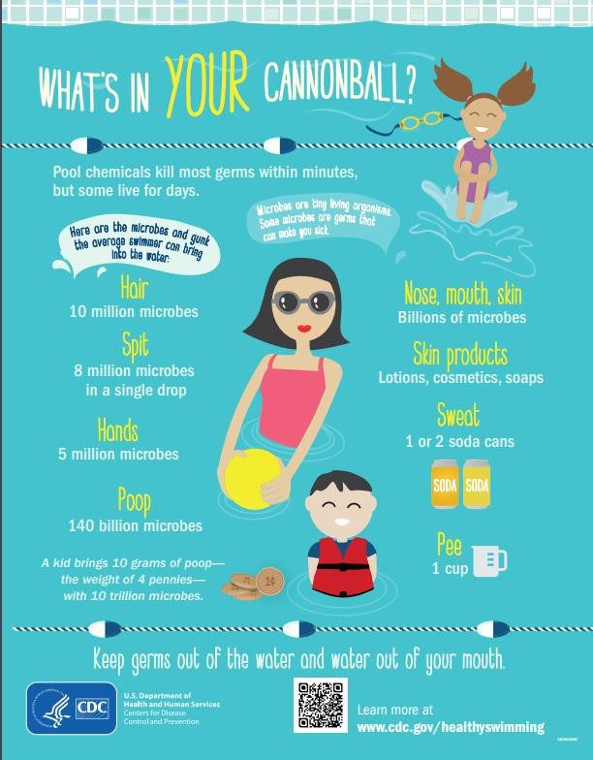

Slide 49
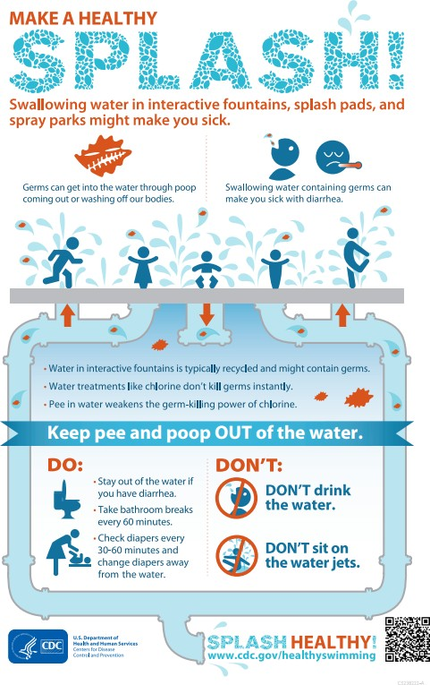

Slide 50
Questions? Comments?

Slide 51


